Slide 1
₹
FINSIGHT
Finance Analysis Dashboard
Real-Time Insights into Transactions, Customers & Risk
A Power BI analytics project covering transaction monitoring, customer segmentation, and risk visibility
Prepared by Kishore Kumar

Slide 2
Project Overview
FinSight is a real-time finance analytics dashboard built to give a unified view of transaction activity, customer behavior, and operational risk for a financial services business.
PROJECT SNAPSHOT
PLATFORM
Microsoft Power BI
•
Track
REPORTING YEAR
Monitor total transaction volume, value, fees, and tax collected across the year
2024
Segment
CORE VIEWS
•
Overview Analysis, Transaction Detail
Break down performance by customer segment, gender, state, and occupation
DIMENSIONS
Customer segment, state, gender, occupation, category
•
Assess Risk
Surface transaction status (success / failed / pending) to flag operational issues
TRANSACTION TYPES
9 types — Deposit, Withdrawal, Bill Payment, Loan EMI, Transfer, and more
INTERACTIVITY
Slicers for year, metric, occupation, and category
FinSight — Finance Analysis Dashboard
2

Slide 3
Key Metrics at a Glance
FY 2024 · Total Amount view
₹21.65M
2.44K
₹8.87K
₹33.62K
₹6.05K
Total Amount
Total Transactions
Avg. Transaction Value
Total Fees
Total Tax
+2.58% vs prior year
+891.40K% vs prior year
+2.12% vs prior year
-3.96% vs prior year
-82.71% vs prior year
Metrics reflect FinSight's live Power BI cards, driven by the dynamic-metric and year slicers.
FinSight — Finance Analysis Dashboard
3

Slide 4
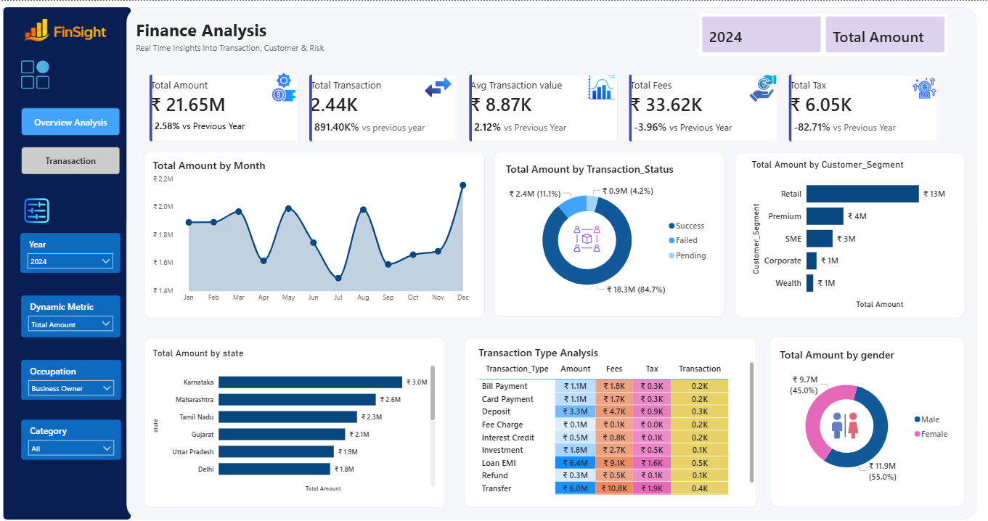
Overview Analysis
Monthly trend, transaction status, customer segment, geography, and gender split — all on one page
FinSight — Finance Analysis Dashboard
4

Slide 5
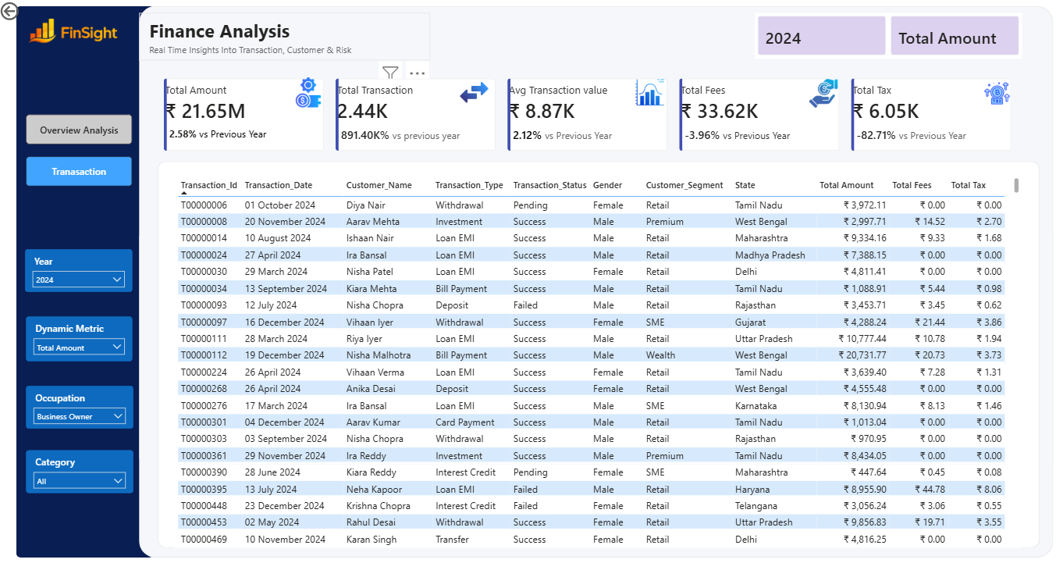
Transaction Detail View
Drill-through grid of individual transactions with customer, status, segment, and geography fields
FinSight — Finance Analysis Dashboard
5

Slide 6
Key Insights
1
Success dominates
2
Retail leads by far
84.7% of total amount (₹18.3M) sits in successfully completed transactions; only 4.2% is failed.
The Retail segment accounts for ₹13M of total amount — more than 3x every other segment combined.
3
Karnataka on top
4
Near-even gender split
Karnataka (₹3.0M), Maharashtra (₹2.6M), and Tamil Nadu (₹2.3M) are the leading states by amount.
Female customers drive 55% (₹11.9M) of total amount vs. 45% (₹9.7M) for male customers.
5
Transfers & Loan EMIs are the biggest categories
6
December is the peak month
Transfer (₹6.0M) and Loan EMI (₹6.4M) lead all transaction types, alongside the highest fees and tax.
Total monthly amount swings between ₹1.4M and ₹2.2M, peaking sharply in December after a mid-year dip.
FinSight — Finance Analysis Dashboard
6

Slide 7
Tools & Approach
1
2
3
4
Data Modeling
DAX Measures
Interactive Filtering
Layout Design
Structured transaction, customer, and calendar tables into a star-schema-style model for fast slicing.
Built measures for total amount, fees, tax, average transaction value, and year-over-year variance.
Added slicers for year, dynamic metric, occupation, and category to let users reshape every visual on demand.
Paired a KPI card strip with trend, distribution, and breakdown visuals across two linked report pages.
FinSight — Finance Analysis Dashboard
7

Slide 8
Takeaways & Next Steps
SUMMARY
FinSight turns raw transaction records into a single, filterable view of volume, revenue, risk, and customer mix — giving stakeholders a fast read on where the business's money is moving and where it's getting stuck.
PLANNED EXTENSIONS
→
Add a dedicated Risk page flagging high-value failed/pending transactions
→
Introduce customer-level RFM and churn indicators alongside transaction metrics
Thank you
→
Automate month-over-month refresh from a live transactional data source
→
Add drill-through from summary cards straight into the transaction detail grid
FinSight — Finance Analysis Dashboard
8

